Slide 1
Speaking in Groups
Brandon Straight

Slide 2
Small groups & Teams
Small group- individuals connected by common purpose
Team- individuals have clearly defined roles
Synchronous
Meeting at the same time or place
Asynchronous
Not meeting or communicating at the same time
Notes:
Team- (Still have all components of small group)

Slide 3
Small group stages
Forming
Small talk time
Storming
Conflict occurs
Norming
Cohesion begins to form and norms are established
Performing
People begin to complete the tasks
Adjourning
Return to individual focus
Notes:
Forming:
In the forming stage, group members come together and get to know each other. There's often a focus on politeness and getting acquainted. Members may be cautious and try to understand their roles within the group. At this stage, there is usually a dependence on the leader for guidance.
Storming:
The storming stage is marked by increased conflict and competition within the group. Members may challenge the leader's authority, and differences of opinion become more apparent. This stage is crucial for the group to establish its identity and for members to learn how to work together effectively.
Norming:
Norming is characterized by the resolution of conflicts and the development of a sense of cohesion within the group. Members start to accept the authority of the leader, and norms and rules are established. There is a growing sense of unity and a willingness to collaborate.
Performing:
In the performing stage, the group is highly functional, and members work together efficiently toward common goals. Roles are well-defined, and there is a high level of trust and cooperation. The group demonstrates synergy, achieving more collectively than the sum of individual efforts.
Adjourning (or Mourning):
The adjourning stage occurs when the group disbands or completes its task. If the group has developed strong relationships, there may be a sense of loss or sadness as members go their separate ways. This stage is often overlooked in discussions about group development, but it's important, especially for groups that have worked closely together over an extended period.

Slide 4
Group Think
Groupthink was coined by Irving Janis
This is when individuals surrender their own beliefs to adopt the group's beliefs
What are ways to counteract this?
Notes:
https://www.youtube.com/watch?v=6J3b9d3Dhc0

Slide 5
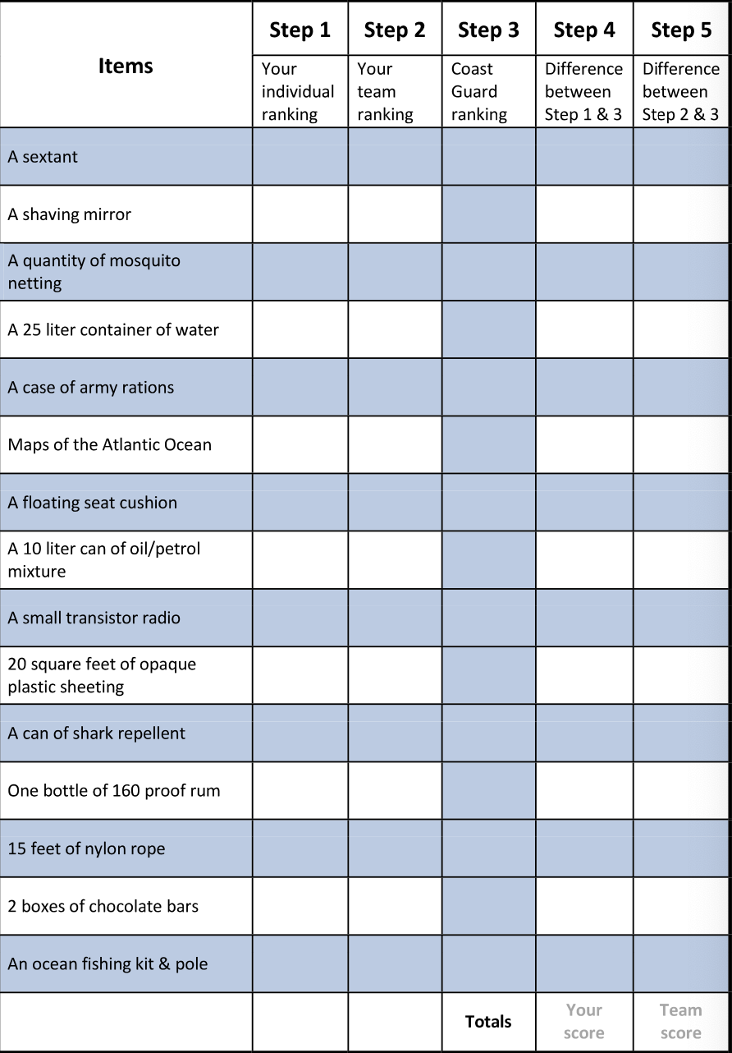
Coastguard Reasoning

Slide 6
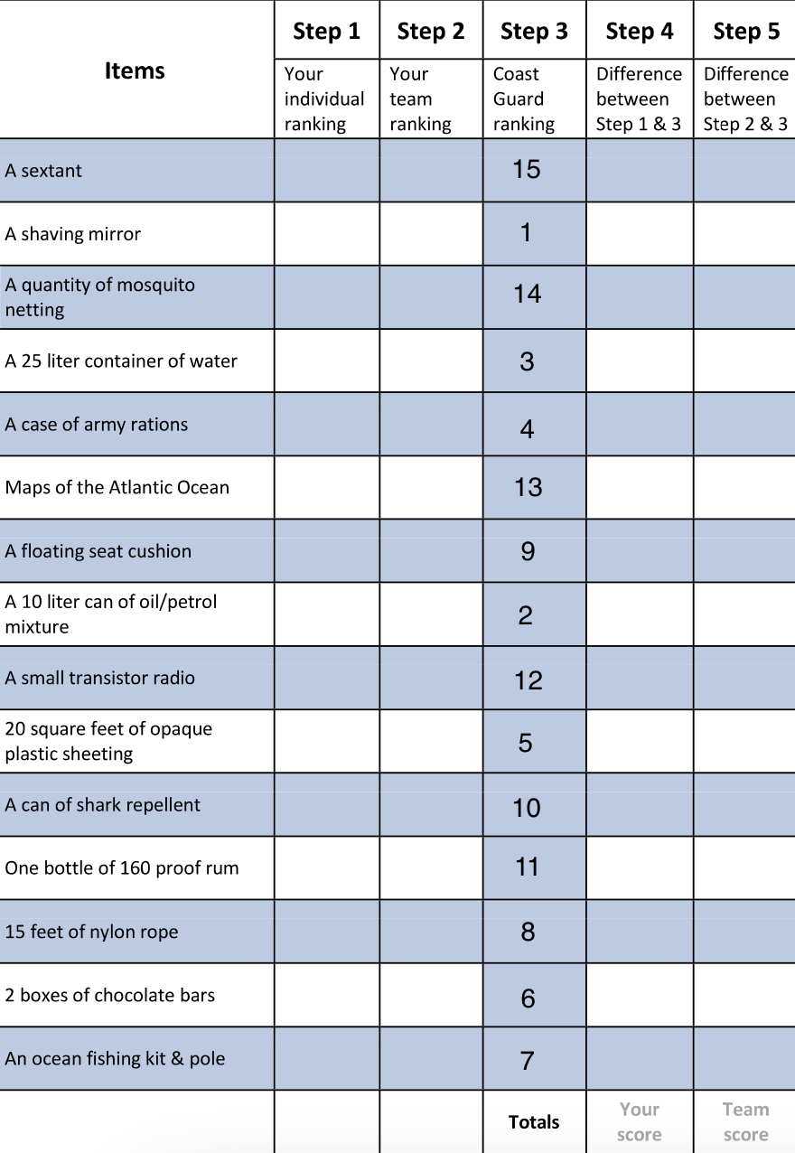
Coastguard Reasoning

Slide 7
Small group types
Brainstorming groups
Problem-solving groups
Personal Growth Groups
Notes:
Lemon ex. Fall of house of usher
https://www.youtube.com/watch?v=rIK-q6JoOeU

Slide 8
Brainstorming Group
A small group dedicated to generating ideas
4 rules
No evaluations
Quantity is the goal
Combinations and extensions of ideas are encouraged
Freewheeling (developing as wild of an idea possible)

Slide 9
Personal growth group
Are commonly seen as support groups
Encounter
Sensitivity groups, form of psychotherapy
Assertive training group
Increase individuals to stand up for their rights and act more assertive
Consciousness raising group
Help people cope with problems in society
Intervention group
Help someone overcome a problem.
Notes:
Encounter
Bring out the olives
https://www.youtube.com/watch?v=6bAm9VY0XFU

Slide 10
Problem solving group
Meets to solve a problem or reach a decision on an issue
Problem solving sequence contains 6 steps
Define and analyze the problem
Establish the criteria for evaluating solutions
Identify possible solutions
Evaluate solutions
Select the best solutions
Test selected solutions

Slide 11
roles in the group
Group task roles
Information seeker
Initiator contributor
Elaborator
Evaluator-critic
Procedural technician
Notes:
Roles- are the patterns of we usually exhibit

Slide 12
roles in the group cont…
Group building and maintenance roles
Encourager or harmonizer
Compromiser
Gatekeeper
Standard setter
follower

Slide 13
roles in the group cont…
Individual roles
Aggressor
Recognition seeker
Blocker
Dominator

Slide 14
Membership Skills
Be Group-oriented
Center conflict on issues
Be critically open-minded

Slide 15
Conflict in groups
Disconfirming messages- messages or words that lack agreement or respect for another person.
Criticism- ex. your lazy, your self-centered
Contempt- when you belittle or ridicule someone ex. you disgust me
Defensiveness- protecting your self-worth by counterattacking ex. You call me a bad driver but you are the one with a DUI
Stonewalling- form of avoidance ex. walking away…

Slide 16
Confirming and Disconfirming Messages
Confirming Messages- convey that you are valued by implying you exist, you matter, your important.
Showing recognition- seems easier said then done a lot of times people are seeing through you with their statements
Acknowledge the other persons thoughts and feelings- Attentive listening is the most common form of acknowledgement
Show that you agree- shows that your interested in other peoples ideas

Slide 17
Spirals of Communication
Relational Spiral- when people respond to the same action and respond with a more intense response
Escalatory conflict spiral- a slight conflict escalates at a rapid rate into a full dispute
Avoidance spiral- instead of fighting individuals will just slowly withdraw from the relationship
Positive spiral- confirming messages can lead to more confirming messages

Slide 18
Gender differences in conflicts
https://www.youtube.com/watch?v=_bqhVqTuFO4

Slide 19
Gender and conflict style
Physiological differences
During conflict men tend to experience greater physical arousal than women which comes in the form of increased heart rate and blood pressure.
Evolutionary explanation- men are trained to compete for their mate
Early socialization
Playground examples- boys by 6 years old will gravitate towards large groups where there are clear understanding of who outranks whom. Boys play team based games
Young girls play games that improve their interpersonal skills this leads girls to engage in more pro social behavior
Notes:
There are commonalities of course

Slide 20
Gender and conflict style cont..
Conflict Dilemmas
Women who are more assertive may come off as being harsh
Women are more likely to compromise and do not usually like to seek conflict head on
Men are awarded for being competitive and assertive

Slide 21
Leadership myths
The skills of leadership are rare
Leaders are born
Leaders are all charismatic
https://www.youtube.com/watch?v=4qQ6UcU_JiE

Slide 22
Group Speaking Tips
Present solution in a nonthreatening manner
Present new solutions tentatively
Try to link changes to known problems in the organization
Say why you think the solution will work
State the negatives
Relate your solution to the members needs and interests

Slide 23
The Ocean Liner Worksheet
An explosion destroyed an ocean liner traveling to San Francisco.
A lifeboat was thrown clear of the explosion and 10 people plus yourself have made it to safety. After a few moments, everyone realizes the boat has a puncture in it and is sinking fast.
There is a small rubber raft aboard the boat that will be able to take you and the passengers to safety. Everyone else will die.
You choose the 4 people who will go on the raft with you to survive.
Below is a list of the 10 passengers currently on the boat with you. Which 4 fellow survivors you choose?

Slide 24
1. Dr. John Keller
Age 67, He specializes in rare diseases and has given his life to the service of medicine and selflessly helping others.
2. Rev. Michael Maller
Age 35, He is an african-american who has a military style. He is a political and spiritual leader to troubled youth.
3. Lucy Taylor
Age 30, She is a successor to naomi wolf and a spokesperson for the women's rights movement.
4. Bliff Smith
Age 42, He is a wealthy banker, has done a large amount of community service, and is the father of triplets.
5. Laura Smith
Age 22, She is pregnant and bliff's wife. She is a prominent member at the country club and is in her ninth month of pregnancy.
6. Thomas Sowell
Age 21, He is a student at the local university and a leader of a group dedicated to cleansing the campus of liberals. He is also the sole supporter of his mother and younger sister.
7. Jimmy Lorenzo
Age 50, He is a reformed criminal and is on his way to testify against the largest organized crime ring in history.
8. Joseph Brooks
Age 40, He is a former member of the Navy Seals and is dying of cancer.
9. Erin Mueller
Age 47, She is a nurse, gets regular panic attacks, and can't swim.
10. Bob Pratt Age 29, He has an Olympic gold medal and is the father of six.

